Slide 1
GAN-based Framework for Control of Robotic Arm Manipulators Bachelor Thesis - Initial Presentation
Jeaustin Calderón Quesada
March 25th, 2025
Notes:
Good afternoon. My name is Jeaustin Calderón, and I will be doing the initial presentation of my Bachelors thesis. Named GAN-based framework for control of robotic arm manipulators.

Slide 2
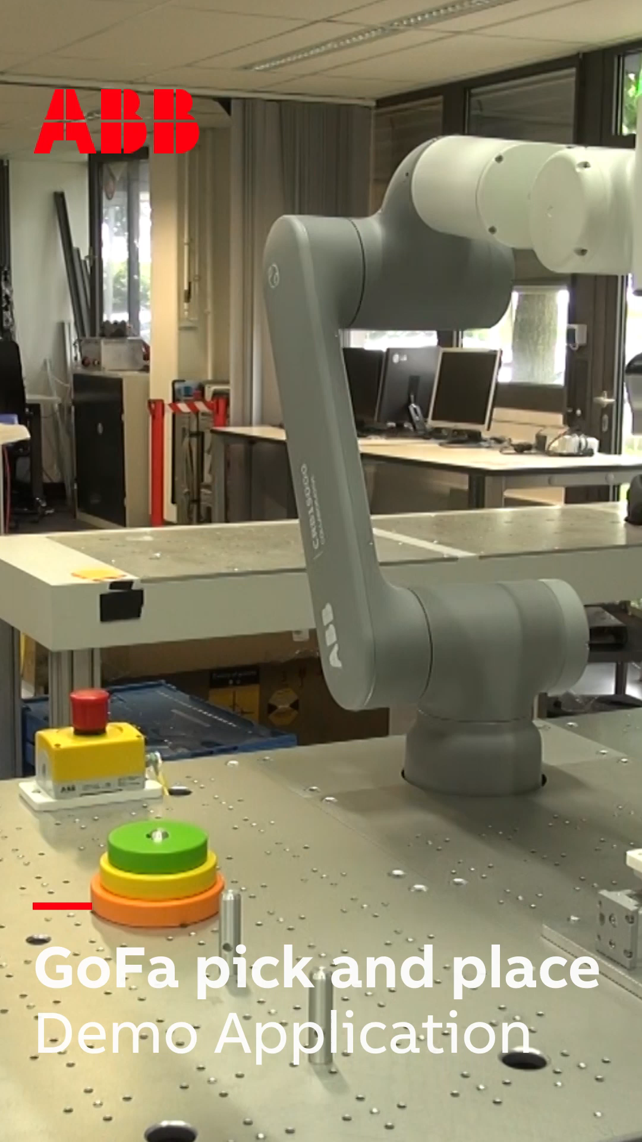
Problem Description
The requirements for the controller of the robotic arm manipulator:
Real-Time control capability
Real-Time constraint following capability
Robustness and generalization capability of changing dynamic models.
Jeaustin Calderón Quesada | March 25, 2025 | GAN-based Framework for Control of Robotic Arm Manipulators
Notes:
Collaborative Robots or Cobots are crucial, as robotics continues to move from structured factory floors into more dynamic and uncertain environments. To achieve that, a controller must meet three essential demands: real-time control, strict adherence to physical and safety constraints, and the ability to generalize across varying conditions. And that’s exactly where my project comes in. The goal is to develop a control framework that handles these demands using AI-based methods, especially Generative Adversarial Networks.

Slide 3

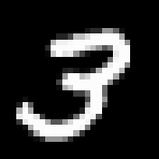




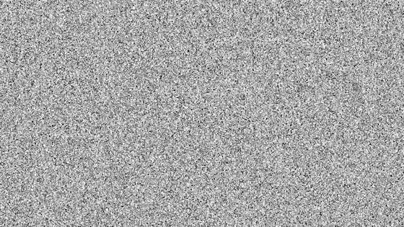
Generative Adversarial Networks (GAN) [1]
Reference
data
Discriminator
Real?
Noise
Generator
Generated data
Loss value
Jeaustin Calderón Quesada | March 25, 2025 | GAN-based Framework for Control of Robotic Arm Manipulators
Notes:
Now I will provide an overview of Generative Adversarial Networks, or GANs.
They were originally proposed for generating synthetic data. They learn to mimic complex samples from a reference dataset.
The general idea of GANs is two Neural Networks competing. A generator and a discriminator.
The generator tries to fool the discriminator into thinking that generated data is real.
On the other hand, the discriminator tries to keep up by using both synthetic data and real data to learn to differenciate them.
CLICK Here is an example with a well-known dataset.
CLICK Firstly, random noise is fed to the generator.
CLICK Then, the generator outputs a synthetic sample that will be evaluated by the discriminator. This discriminator then says how likely it is that the data is real or fake.
CLICK Lets say that in this case the generator was able to fool the discriminator.
CLICK So it will take this as feedback and improve. The discriminator needs to keep up so it uses this past sample AND samples from the reference trajectory.
CLICK Evaluates them and
CLICK Updates itself
On the long run it will result in a generator able to create indistínguishable hand written numbers.

Slide 4
Reinforcement Learning (RL) [2]
State
Policy
Action
Reward
Reward function
Physics simulator
New State
Jeaustin Calderón Quesada | March 25, 2025 | GAN-based Framework for Control of Robotic Arm Manipulators
Notes:
Typically Reinforcement Learning works like this:
the policy is the brain of the controller — it decides which actions the robot should take according to the current state.
These actions are tested in a physics simulator, which mimics the real robot’s environment.
Based on the outcome, a reward function tells the policy how good or bad that action was.
Over time, the policy learns to maximize rewards and that’s how it learns to control the robot effectively.
WIDER DIAGRAM

Slide 5
GAN and Reinforcement Learning
GAN:
Reference
data
Discriminator
Noise
Generator
Generated data
RL:
Loss value
Reward function
Reward
Policy
Action
Physics simulator
State
Jeaustin Calderón Quesada | March 25, 2025 | GAN-based Framework for Control of Robotic Arm Manipulators
Notes:
Now please keep these two concepts in mind.
I will re-organize the GAN diagram for visual interpretation.

Slide 6
GAN and Reinforcement Learning
GAN:
Reference
data
Noise
Discriminator
Loss value
Generator
Generated
data
RL:
Reward function
Reward
Policy
Action
Physics simulator
State
Jeaustin Calderón Quesada | March 25, 2025 | GAN-based Framework for Control of Robotic Arm Manipulators
Notes:
And now: How am I going to merge this two concepts to exploit their potential and benefits?
I will then use the discriminating part of the GAN to substitute the reward function. While combining the concepts of policy and generator to create control signals based on the currents state and also on the desired future states.

Slide 7
GAN and Reinforcement Learning
Reward function
Reference
data
Reference
trajectories
Desired future states
Noise
Discriminator
Policy (Generator)
Action
Generator
Physics simulator
Reward function
Policy
Reward
State
Jeaustin Calderón Quesada | March 25, 2025 | GAN-based Framework for Control of Robotic Arm Manipulators
Notes:
"In this high-level diagram, we see how the control framework is structured.
The reward function is guided by reference trajectories — essentially showing what the ideal behavior should look like.
Then, the discriminator evaluates how closely the actual system trajectory — driven by the policy’s actions — matches the reference. Based on that similarity, it generates a reward signal.
The policy uses this reward to improve its actions, learning to generate better control commands based on the system’s current, past, and desired future states.
Meanwhile, the discriminator keeps updating to better distinguish between ideal and actual trajectories — creating a feedback loop where both the policy and the discriminator improve together.
This creates a hybrid control structure — combining RL and GAN-like training — that pushes the policy toward more realistic and constraint-respecting behavior."

Slide 8
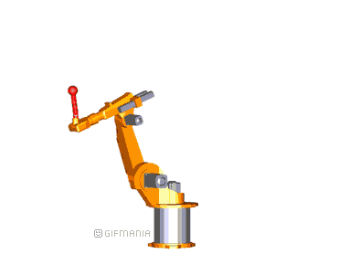
Why do we even need GANs at all? What is the novelty here?
Improved Computational Load compared to MPC
This approach is expected to improve the execution time and computational complexity of conventional paradigms like Model Predictive Control (MPC), making it an attractive alternative.
No Explicit Reward Functions
This approach eliminates the need for manually crafting a reward function, which is a complex task in traditional reinforcement learning. This is substituted by the discriminator and the expert samples.
Constraint handling
Extension of the reward formulation to enforce physical and safety constraints (e.g., velocity, acceleration, end-effector limits), enabling the learned policy to satisfy constraints not explicitly enforced in the reference expert trajectories..
Adaptability to Real-World Changes
By leveraging collected data, this method is expected to adapt to variations in the real-world model, ensuring robustness in dynamic environments. By using methods such as Residual Learning or Online Fine-Tuning.
Jeaustin Calderón Quesada | March 25, 2025 | GAN-based Framework for Control of Robotic Arm Manipulators
Notes:
Explain number 2. Why we don’t need the explicit reward function.
Explain the innovation.

Slide 9
Thank you for your attention!
Feel free to ask any questions
Notes:
Make statements on the existing concepts. Explain what the novelty is and what the shortcomings of the past work are.

Slide 10
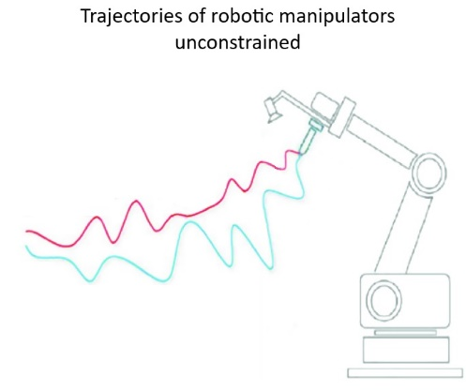
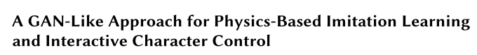
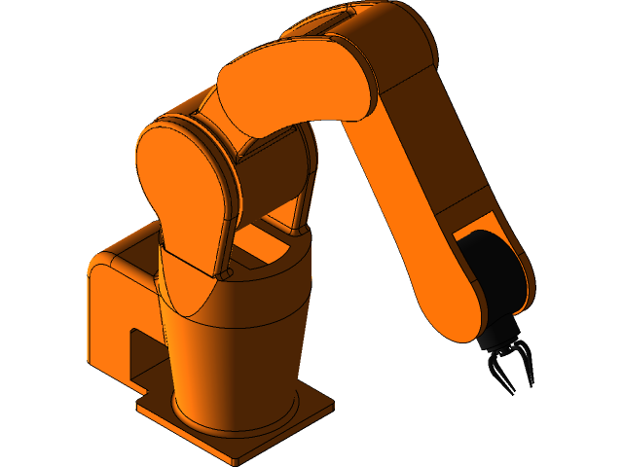
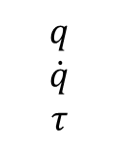
Work steps
Literature Research
[3] [4] [5]
Dataset generation and env setup [6]
Unconstrained Learning [7]
MPC
f
$$q$$
$$\dot{q}$$
$$τ$$
Jeaustin Calderón Quesada | March 25, 2025 | GAN-based Framework for Control of Robotic Arm Manipulators

Slide 11
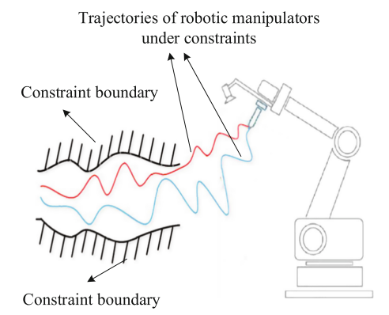
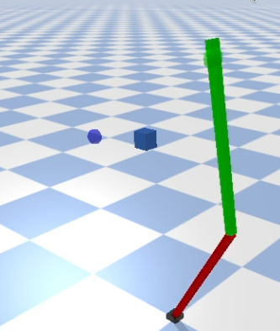
Work steps
Unconstrained Learning [7]
Constrained Learning [7]
Validation
l
Jeaustin Calderón Quesada | March 25, 2025 | GAN-based Framework for Control of Robotic Arm Manipulators
Notes:
file:///C:/Users/Usuario%20MSI/Desktop/978-3-030-27535-8.pdf 594

Slide 12
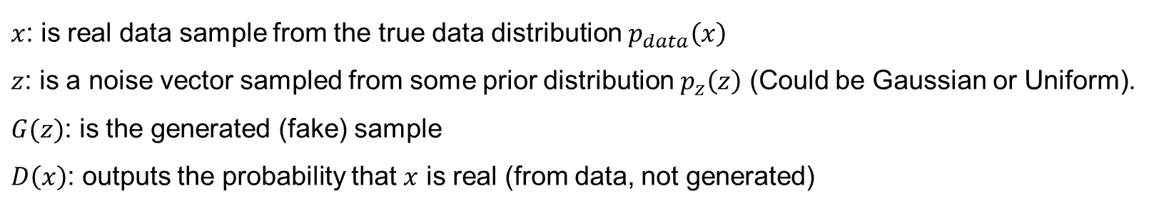
GAN’s loss function [1]
$$\min_{G}{\max_{D}{ ℒ_{GAN}(D, G)}}=Ε_{x\sim p_{data}\left(x\right)}\left(logD\left(x\right)\right)+Ε_{z\sim p_{z}\left(z\right)}\left[\log\left(1−D\left(G\left(z\right)\right)\right)\right]$$
$x$: is real data sample from the true data distribution $p_{data}\left(x\right)$
$z$: is a noise vector sampled from some prior distribution $p_{z}\left(z\right)$ (Could be Gaussian or Uniform).
$G(z)$: is the generated (fake) sample
$D\left(x\right)$: outputs the probability that $x$ is real (from data, not generated)
Jeaustin Calderón Quesada | March 25, 2025 | GAN-based Framework for Control of Robotic Arm Manipulators

Slide 13
GAN and Reinforcement Learning
Desired future states
Future desired states
Reward function
Robot, task and environment
description
Trajectory planning algorithm
1
Reference
trajectories
Discriminator
Policy (Generator)
Action
Physics simulator
Reward function
Policy
1
Reward
State
Jeaustin Calderón Quesada | March 25, 2025 | GAN-based Framework for Control of Robotic Arm Manipulators

Slide 14
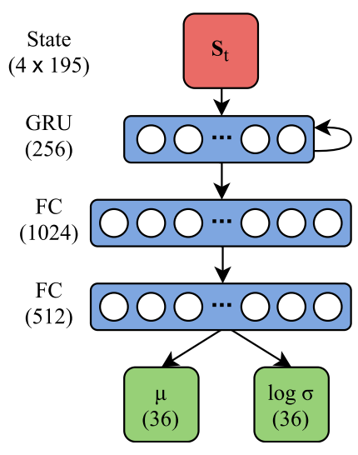
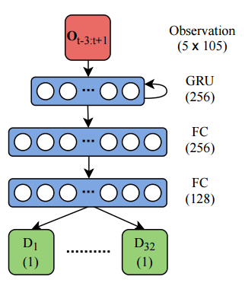
Reference Policy and Discriminator Architecture [4]
Jeaustin Calderón Quesada | March 25, 2025 | GAN-based Framework for Control of Robotic Arm Manipulators

Slide 15
Constraints
 | Enforced by Trajectory planner | Enforced by MPC | Controller learns to enforce
1. Joint position | Yes | Yes
2. Joint velocity |  | Yes | Yes
3. Joint acceleration |  | Yes | Yes
4. Joint torque limits |  | Yes | Yes
5. End-Effector position | Yes | Yes
6. End-Effector velocity |  | Yes | Yes
Jeaustin Calderón Quesada | March 25, 2025 | GAN-based Framework for Control of Robotic Arm Manipulators

Slide 16
Observation space
rad
Desired trajectory
Current step
Future desired states (N)
rad
Actual trajectory
Past states (M)
Steps

Slide 17
References
[1] I. J. Goodfellow, J. Pouget-Abadie, M. Mirza, B. Xu, D. Warde-Farley, S. Ozair,A. Courville, and Y. Bengio, “Generative adversarial networks,” 2014. [Online].Available: https://arxiv.org/abs/1406.2661
[2] R. S. Sutton and A. G. Barto, Reinforcement Learning: An Introduction, 2nd ed. MITPress, 2018. [Online]. Available: http://incompleteideas.net/book/the-book-2nd.html
[3] M. Jegorova, J. Smith, M. Mistry, and T. Hospedales, “Adversarial generation of informative trajectories for dynamics system identification,” in 2020IEEE/RSJ International Conference on Intelligent Robots and Systems (IROS), DOI10.1109/IROS45743.2020.9340801, pp. 7109–7115, 2020.
[4] P. Xu and I. Karamouzas, “A gan-like approach for physics-based imitation learning and interactive character control,” Proceedings of the ACM on Computer Graphics and Interactive Techniques, vol. 4, DOI 10.1145/3480148, no. 3, p. 1–22, Sep. 2021. [Online]. Available: http://dx.doi.org/10.1145/3480148
[5] J. Ho and S. Ermon, “Generative adversarial imitation learning,” 2016. [Online]. Available at: https://arxiv.org/abs/1606.03476
[6] GrabCAD, “2 DOF Robot Arm,” GrabCAD Library. [Online]. Available: https://grabcad.com/library/2-dof-robot-arm-1
[7] J. Cacace, D. Finocchiaro, and V. Lippiello, “A survey on control of roboticmanipulators with reinforcement learning,” in Applications of Robotics in IndustryUsing Advanced Mechanisms, M. Ceccarelli and A. Carbone, Eds., pp. 535–544. Cham:Springer, 2019. [Online]. Available: https://doi.org/10.1007/978-3-030-27535-8
Jeaustin Calderón Quesada | March 25, 2025 | GAN-based Framework for Control of Robotic Arm Manipulators

